Slide 1
Representing Algorithms
Mack 2022
Notes:
Last updated: 11-28-2022

Slide 2
Warm Up

Slide 3

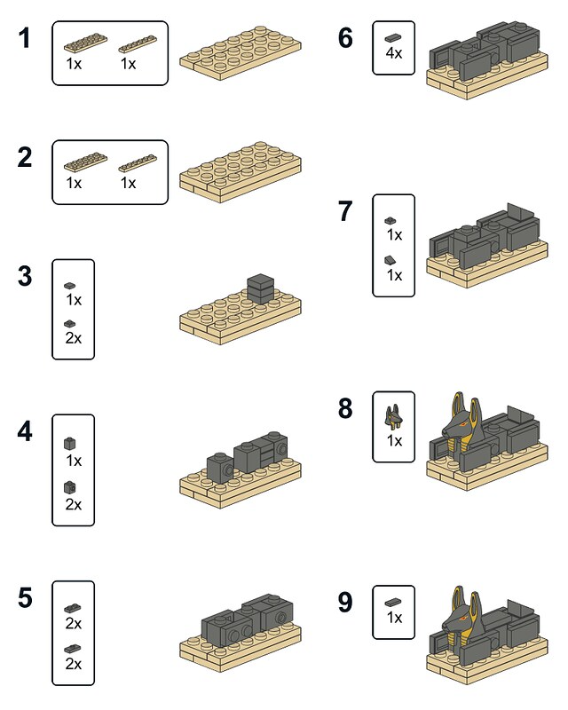
Building Lego
Starter activity
Imagine giving these Lego instructions to five different people.
Question: Do you think that everyone's finished product will look the same? Why?
Think, write, pair, share.
Notes:
Image source: https://www.flickr.com/photos/pasukaru76/7327173838/

Slide 4

Representing algorithms
Objectives
In this lesson, you will:
Describe the difference between algorithms and computer programs
Identify algorithms that are defined as written descriptions, flowcharts and code
Analyse and create flowcharts using the flowchart symbols

Slide 5
Activity 1

Slide 6

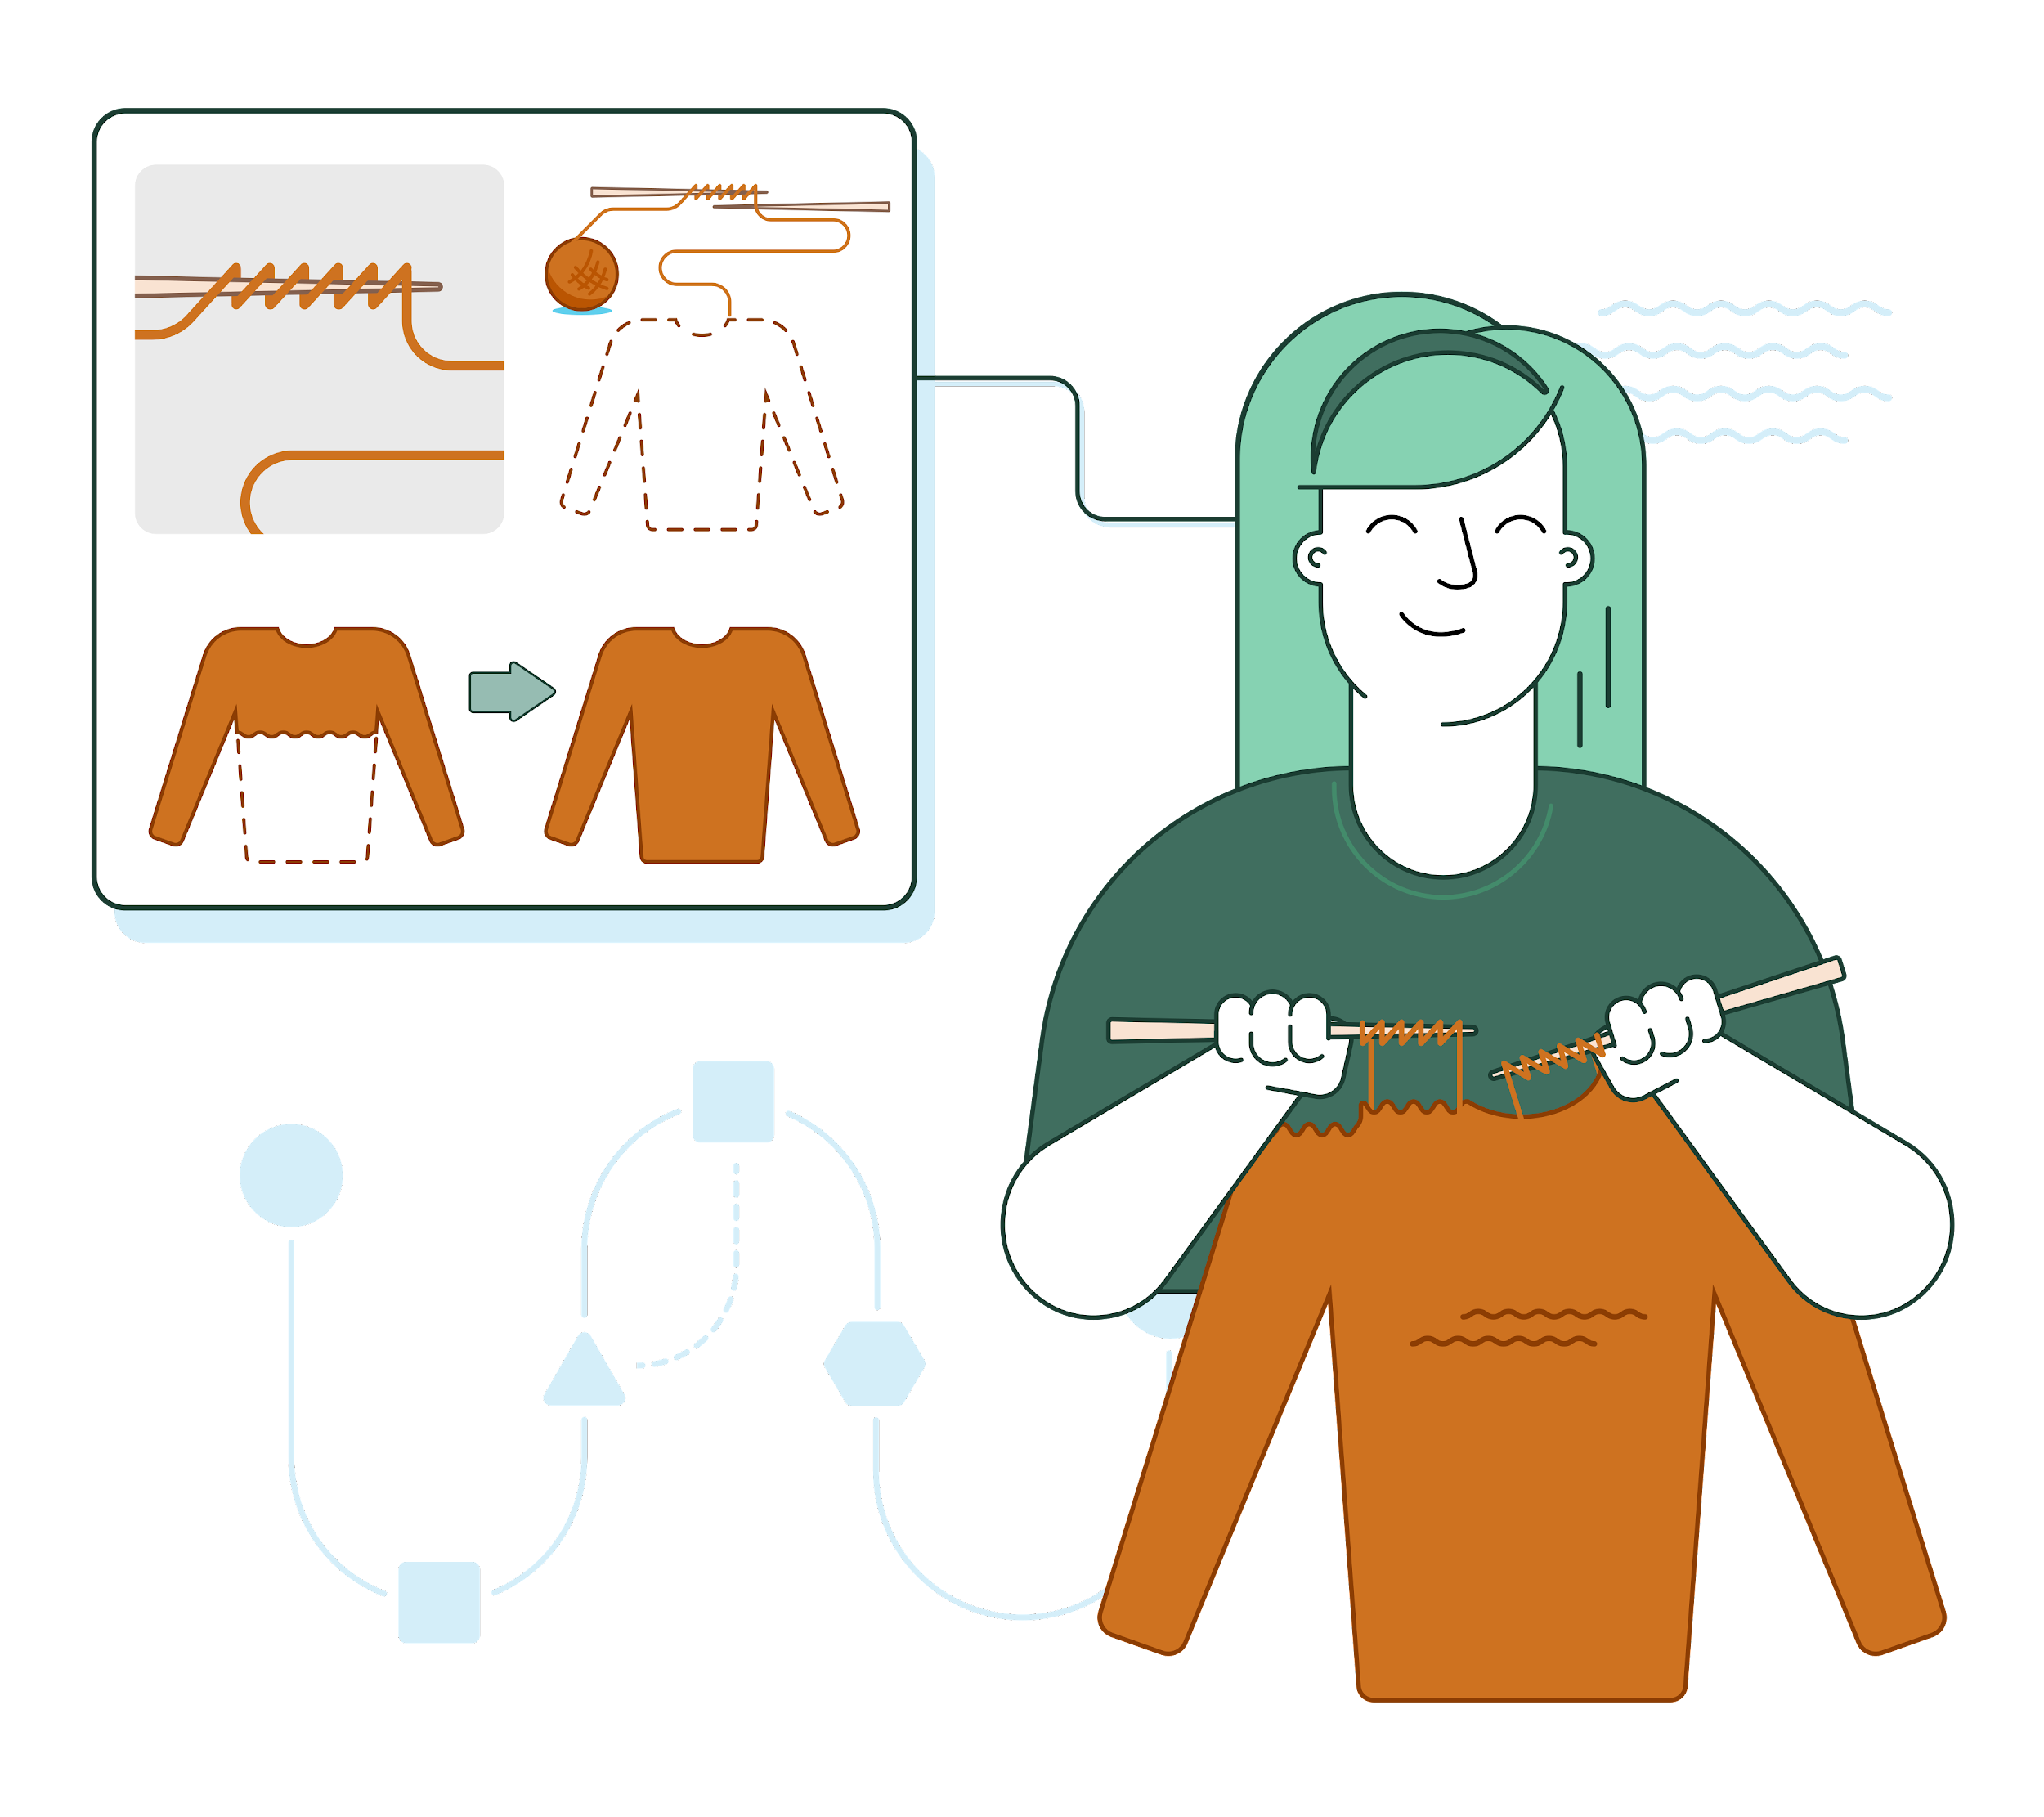
Algorithms
Activity 1
An algorithm is a set of precise instructions, expressed in some sort of language (e.g. textual, visual).
Understanding the language is necessary in order to execute the instructions.
Executing these instructions is meant to solve a problem.

Slide 7
Algorithms and computer programs
Activity 1
The terms algorithms and computer programs can often overlap but are distinct from one another.
What do you think the difference is between an algorithm and a computer program?

Slide 8
Algorithms and computer programs
Activity 1
An algorithm describes the logic of a solution.
A computer program is an implementation of this solution, written in a programming language.
Programs written in a programming language are precise enough for a machine to translate and then execute.

Slide 9
Activity 2

Slide 10
Representing algorithms
Activity 2
In computer science, algorithms can be represented in a number of ways, not only in a programming language.
For instance, you can use flowcharts and written descriptions to help you to focus on the logic of a solution without worrying about syntax errors.
This can massively speed up the development time of a program.

Slide 11
Flowcharts
Activity 2
Start
A flowchart can be used to visually represent an algorithm or program.
Arrows are used to signify the flow of the program.
What does this algorithm do?
Input
year_born
Input
current_year
result = current_year - year_born
Output
result
End

Slide 12
Written descriptions
Activity 2
Start
A written description can also be used to specify the steps of an algorithm:
Ask the user for the year they were born.
Ask the user for the year it currently is.
Subtract the current year by the year born.
Tell the user how old they will be this year.
Input
year_born
Input
current_year
result = current_year - year_born
Output
result
End

Slide 13
Computer program
Activity 2
Start
Once the logic of an algorithm is planned out, you can use it to help with writing code in a programming language, such as Python:
Input
year_born
Input
current_year
year_born = int(input())
current_year = int(input())
result = current_year - year_born
print(result)
result = current_year - year_born
Output
result
End

Slide 14
Activity 3

Slide 15
Creating flowcharts
Activity 3
In the next activity, you are going to develop a flowchart.
First though, you need to know what the different flowchart symbols are and what they represent.

Slide 16
Flowchart symbols
Activity 3
Terminators are used for the start and end of subroutines or programs.
Arrows are used to show the direction and flow of the program.
Subroutines are represented by a rectangle with two lines either side.
Start
welcome

Slide 17
Flowchart symbols
Activity 3
Output “Hello world!”
Input name
An input or output is represented by a parallelogram.
A process is represented by a rectangle. It is used for an instruction or command.
A decision has two branches, True and False.
age < 16?
False
squared = num1 * num2
True

Slide 18
Written description for coin toss
Activity 3
The following slides go over a step-by-step breakdown of a flowchart for a coin toss game. The instructions for the game can be written as:
Ask the user to guess either “Heads” or “Tails”.
Simulate a coin flip by randomly generating either “Heads” or “Tails”.
Compare the coin flip with the user’s choice.
If the coin flip is the same as the user’s choice, tell the user they won.
Otherwise, tell the user they lost.

Slide 19
Flowchart for coin toss
Activity 3
Start
Begin the flowchart with a start terminator.

Slide 20
Flowchart for coin toss
Activity 3
Start
Output
“Heads or Tails?”
Ask the user to guess either “Heads” or “Tails” and store the response in a variable called choice.
Input choice

Slide 21
Flowchart for coin toss
Activity 3
Start
Output
“Heads or Tails?”
Input choice
flip = Randomly pick “Heads” or “Tails”
Simulate a coin toss by randomly generating either “Heads” or “Tails”. Store this in a variable called flip.

Slide 22
Flowchart for coin toss
Activity 3
Compare the coin flip with the user’s choice.
Start
choice == flip?
Output
“Heads or Tails?”
False
True
Input choice
flip = Randomly pick “Heads” or “Tails”

Slide 23
Flowchart for coin toss
Activity 3
Start
choice == flip?
Output
“Heads or Tails?”
False
True
Input choice
Output
“You won!”
If the coin flip is the same as the user’s choice, tell the user they won.
flip = Randomly pick “Heads” or “Tails”

Slide 24
Flowchart for coin toss
Activity 3
Start
choice == flip?
Output
“Heads or Tails?”
False
True
Input choice
Output
“You won!”
Output
“You lost!”
flip = Randomly pick “Heads” or “Tails”
Otherwise, tell the user they lost.

Slide 25
Flowchart for coin toss
Activity 3
Start
choice == flip?
Output
“Heads or Tails?”
False
True
Input choice
Output
“You won!”
Output
“You lost!”
flip = Randomly pick “Heads” or “Tails”
End
Finish the flowchart with an end terminator.

Slide 26

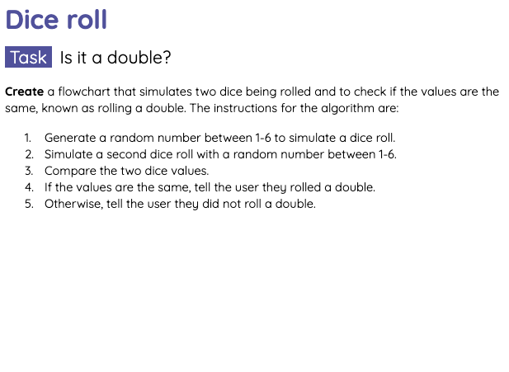
Dice roll
Activity 3
Now it is your turn to create a flowchart for a dice roll simulation.
Use the written description included in the Activity 3 Worksheet to develop your flowchart.

Slide 27
Activity 4

Slide 28
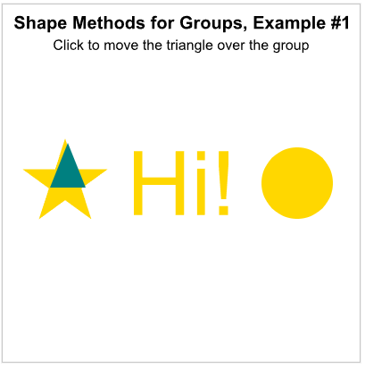
Group Methods
Activity 4
We just saw how groups can use some shape properties. Now we will look into the various methods we can use with groups.

Slide 29

Group Methods
Activity 4
Complete 3 pts of exercises!

Slide 30
Wrap Up

Slide 31

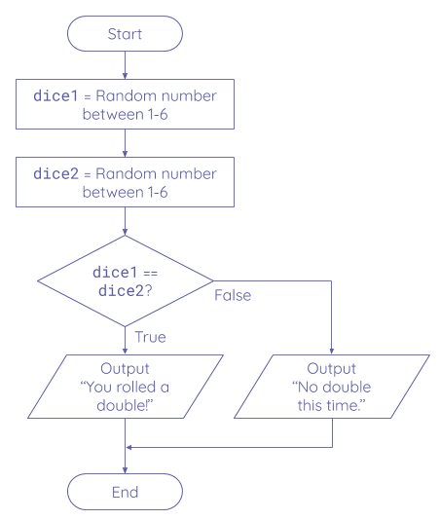
Peer review your flowcharts
Wrap Up
Sit with a partner and peer review your flowcharts.
Check that the logic of the flowcharts will result in the intended outcome.
Use the worksheet solution to help you with this.

Slide 32
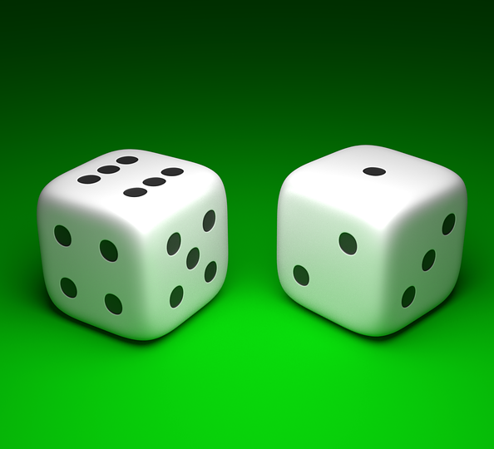
Homework: Odd or even?
Homework
Modify your dice roll flowchart so that it checks whether each dice that was rolled is odd or even.
If a dice is even the flowchart should output “Even”, whilst if the dice is odd the flowchart should output “Odd”.
Due: Next lesson
Notes:
Image source: https://pixabay.com/illustrations/dice-gambling-chance-game-rendered-1842135/

Slide 33
Next lesson
Summary
In this lesson, you…
Described the difference between algorithms and computer programs.
Identified algorithms that are defined as written descriptions, flowcharts and code.
Analysed and created flowcharts using the flowchart symbols.
Next lesson, you will…
Use trace tables to walk through algorithms in code.

